Slide 1
Name: Swapnil Ghosh
Roll: 001911001067
Dept: IT
Group: A2
TASK 6

Slide 2
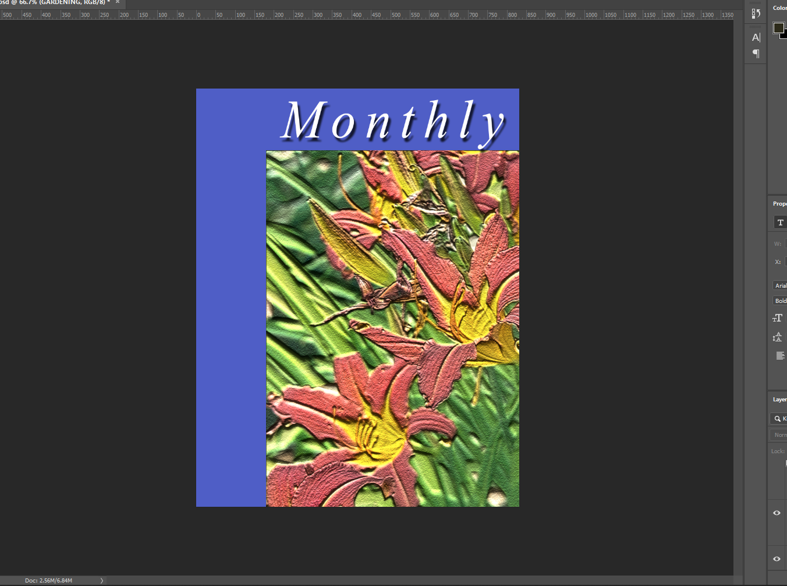
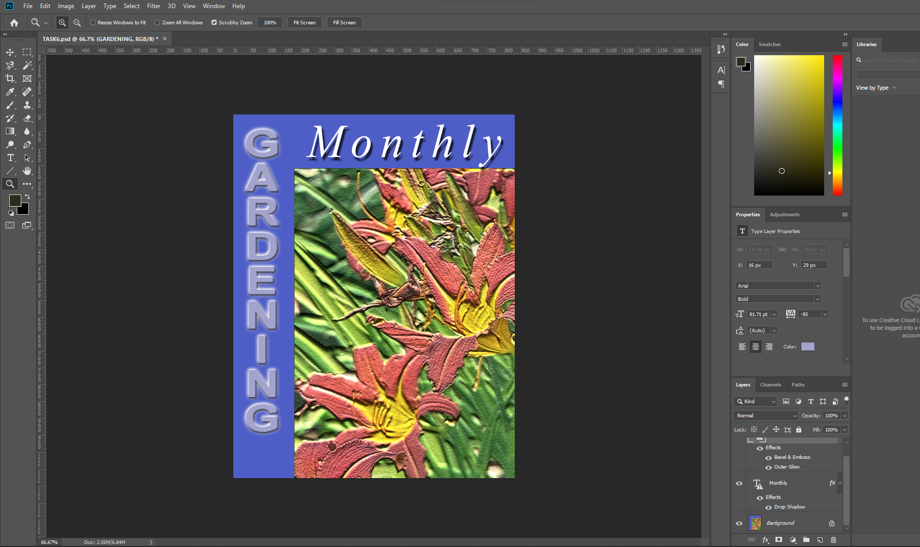
Step-1) Open file GARDEN.TIF in Photoshop
Step-2) Selected Type tool, changed font and wrote the text (“Monthly”) and used move tool to position the text.
Step-3) Added a Drop Shadow to the text , at a distance of 11 px.
Step-5) Selected Type tool(Vertically orient), changed font and wrote the text (“GARDENING”) and used move tool to position the text.
Step-6) Selecting Type tool from Options bar set Tracking value to -85.Changed the properties within Bevel & Emboss, style Outer bevel, Outer Glow and set the distance at 16 px.

